Slide 1
CHAPTER 4
Imperfections in Solids
Chapter Outline
Defects in Solids
  0D, Point defects
    vacancies
    interstitials
    impurities, weight and atomic composition
  1D, Dislocations
    edge
    screw
  2D, Grain boundaries
    tilt
    twist
  3D, Bulk or Volume defects
  Atomic vibrations

Slide 2
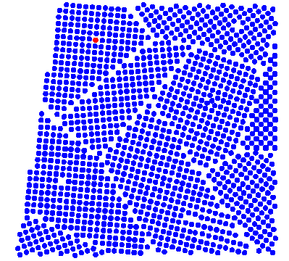
Real crystals are never perfect, there are always defects

Slide 3
Types of Defects
Four categories
depending on their dimension
0D, Point defects:
atoms missing or in irregular places in the lattice (vacancies, interstitials, impurities)
1D, Linear defects:
groups of atoms in irregular positions (e.g. screw and edge dislocations)
2D, Planar defects:
interfaces between homogeneous regions of the material (grain boundaries, external surfaces)
3D, Volume defects:
extended defects (pores, cracks)

Slide 4
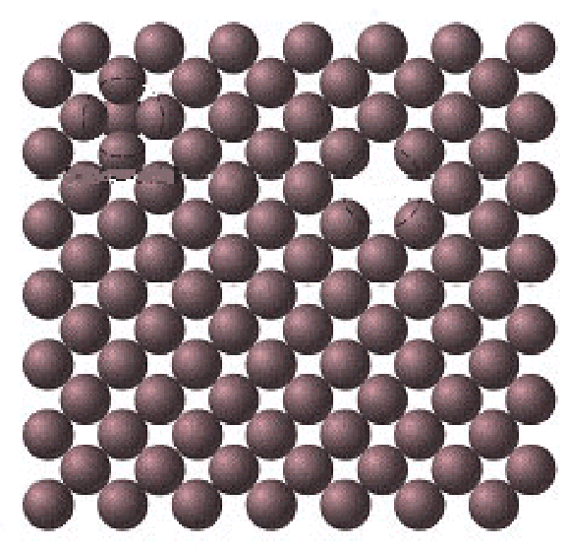
Point defects: vacancies & interstitials
Vacancy
Self-interstitials
Vacancy - lattice position that is vacant because atom is missing.
Interstitial - atom that occupies a place outside the normal lattice position. May be same type of atom (self interstitial) or an impurity interstitial.

Slide 5
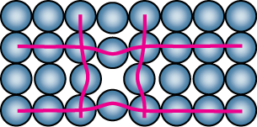
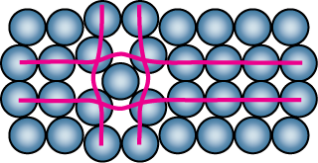
Point Defects
• Vacancies:
-vacant atomic sites in a structure.
Vacancy
distortion
of planes
• Self-Interstitials:
-"extra" atoms positioned between atomic sites.
self-
interstitial
distortion
of planes

Slide 6
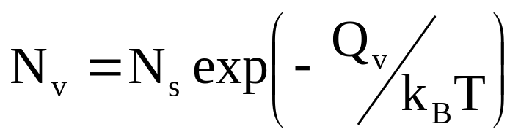
How many vacancies?
Equilibrium number of vacancies is due to thermal vibrations
N_{s} = number of regular lattice sites
k_{B} = Boltzmann constant
Q_{v} = energy to form a vacant lattice site in a
perfect crystal
T = temperature in Kelvin (note, not in ºC or ºF).

Slide 7
Equilibrium Concentration:
Point Defects
• Equilibrium concentration varies with temperature!
No. of defects
Activation energy
N
v
-
Q
v
=
exp
No. of potential
N_{s}
k
T
defect sites.
Temperature
Boltzmann's constant
(1.38 x 10
-23
J/atom-K)
(8.62
x
10
-5
eV/atom-K)
Each lattice site
is a potential
vacancy site

Slide 8
Room temperature in copper: one vacancy per 10¹⁵ atoms.
Just below the melting point: one vacancy for every 10,000 atoms.

Slide 9
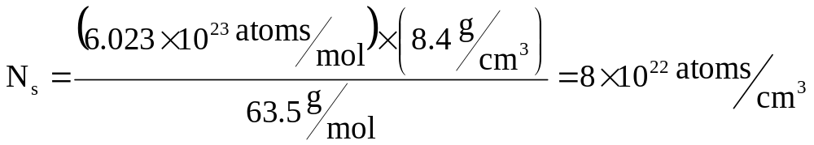
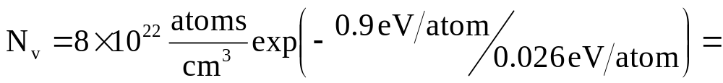

Estimate number of vacancies in Cu at room T
k_{B} = 1.38 × 10⁻²³ J/atom-K = 8.62 × 10⁻⁵ eV/atom-K
T = 27º C + 273 = 300 K.
k_{B}T = 300 K × 8.62 × 10⁻⁵ eV/K = 0.026 eV
Q_{v} = 0.9 eV/atom
N_{s} = N_{A}ρ/A_{Cu}
N_{A} = 6.023 × 10²³ atoms/mol
ρ = 8.4 g/cm³
A_{cu} = 63.5 g/mol

Slide 10
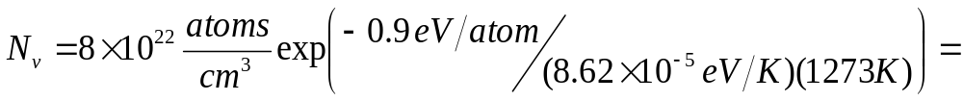

Estimate number of vacancies in Cu at 1000℃
k_{B} = 1.38 × 10⁻²³ J/atom-K = 8.62 × 10⁻⁵ eV/atom-K
T = 1000º C + 273 = 1273 K.
Q_{v} = 0.9 eV/atom
N_{s} = N_{A}ρ/A_{Cu}
N_{A} = 6.023 × 10²³ atoms/mol
ρ = 8.4 g/cm³
A_{cu} = 63.5 g/mol

Slide 11
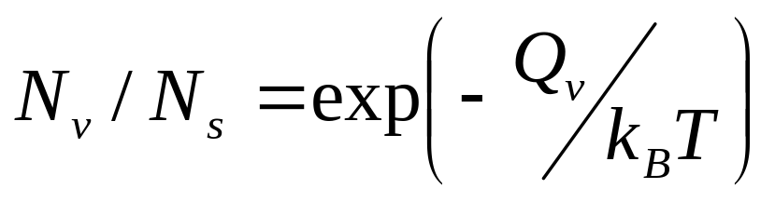
Measuring Activation Energy
• We can get Q_{v} from
an experiment.
• Measure this...
• Replot it...
N
v
N
slope
Ns
v
ln
N
exponential
-
Q
v
/k
dependence!
T
defect concentration
1/
T

Slide 12
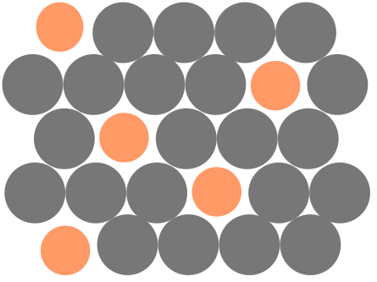
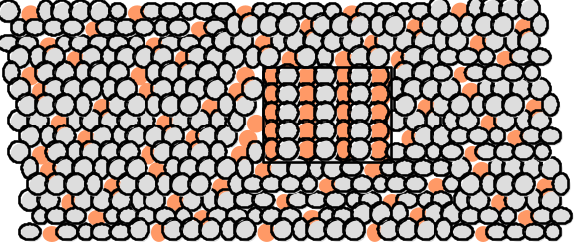
Point Defects in Alloys
Two outcomes if impurity (B) added to host (A):
• Solid solution of B in A (i.e., random dist. of point defects)
OR
Substitutional solid soln.
(e.g., Cu in Ni)
Interstitial solid soln.
(e.g., C in Fe)
• Solid solution of B in A plus particles of a new
phase (usually for a larger amount of B)
Second phase particle
--different composition
--often different structure.

Slide 13
Solid solutions
Host (Solvent or Matrix) dissolves minor component (Solute).
Ability to dissolve is called Solubility.
Solvent: element in greater amount
Solute: element present in lesser amount
Solid Solution:
  homogeneous
  maintain crystal structure
  randomly dispersed impurities
  (substitutional or interstitial)

Slide 14
Factors for high solubility
(Solubility limit → maximum that can dissolve)
Atomic size: need to “fit” ⇒ solute and solvent atomic radii should be within ~ 15%
Crystal structure: solute and solvent the same
Electronegativities: should be comparable (otherwise new intermetallic phases favored)
Valency: If solute has higher valency than solvent, generally more goes into solution

Slide 15
Imperfections in Solids
Conditions for substitutional solid solution (S.S.)
W. Hume – Rothery rule
  1. Δr (atomic radius) < 15%
  2. Proximity in periodic table
    i.e., similar electronegativities
  3. Same crystal structure for pure metals
  4. Valency
    All else being equal, a metal will have a greater tendency to dissolve a metal of higher valency than one of lower valency

Slide 16
Application of Hume–Rothery rules – Solid Solutions
1. Would you predict
more Al or Ag
to dissolve in Zn?
2. More Zn or Al
in Cu?
Element Atomic Crystal Electro- Valence
Radius Structure nega-
(nm) tivity
Cu 0.1278 FCC 1.9 +2
C 0.071
H 0.046
O 0.060
Ag 0.1445 FCC 1.9 +1
Al 0.1431 FCC 1.5 +3
Co 0.1253 HCP 1.8 +2
Cr 0.1249 BCC 1.6 +3
Fe 0.1241 BCC 1.8 +2
Ni 0.1246 FCC 1.8 +2
Pd 0.1376 FCC 2.2 +2
Zn 0.1332 HCP 1.6 +2

Slide 17
Substitutional Solid Solutions
Ni
Cu

Slide 18
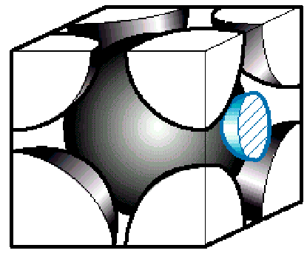
Interstitial Solid Solutions
Carbon interstitial atom in BCC iron
Interstitial solid solution of C in BCC Fe (α phase).
C small enough to fit (some strain in BCC lattice).

Slide 19
Interstitial Solid Solutions
Factors for high solubility:
FCC, BCC, HCP: void space between host (matrix) atoms relatively small
⇒ atomic radius of solute should be significantly less than solvent
Max. concentration ≤ 10%,
(2% for C-Fe)

Slide 20
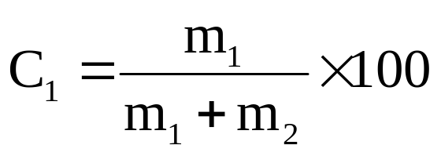
Composition / Concentration
Weight Percent (wt %)
Weight of one element relative to total alloy weight
2 components: concentration of element 1 in wt. %

Slide 21
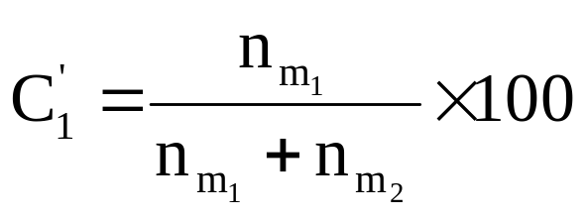
atom percent (at %):
useful in understanding material at atomic level
Number of moles (atoms) of one element relative to total number of moles (atoms) in alloy.
2 component: concentration of element 1 in at. %:
n_{m1}= number density = m’₁/A₁ (m’₁ = weight in grams of 1, A₁ is atomic weight of element 1)

Slide 22
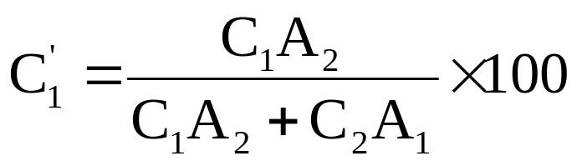
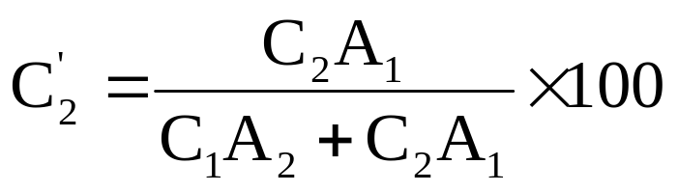
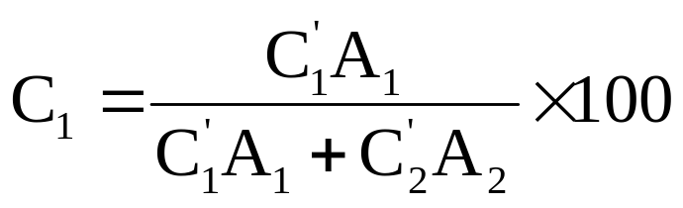
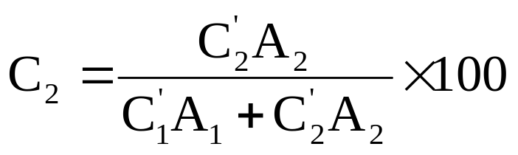
Composition Conversions
Weight % to Atomic %:
Atomic % to Weight %:

Slide 23
Line Defects
Dislocations:
• are line defects,
• slip between crystal planes result when dislocations move,
• produce permanent (plastic) deformation.
Schematic of Zinc (HCP):
• before deformation
• after tensile elongation
slip steps

Slide 24
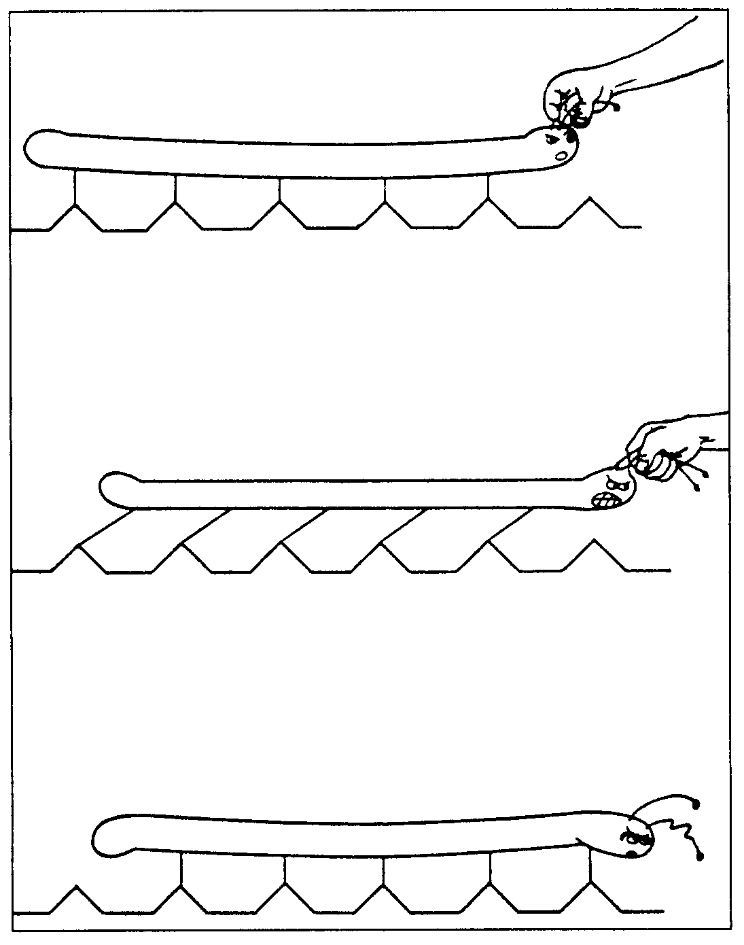

Slide 25
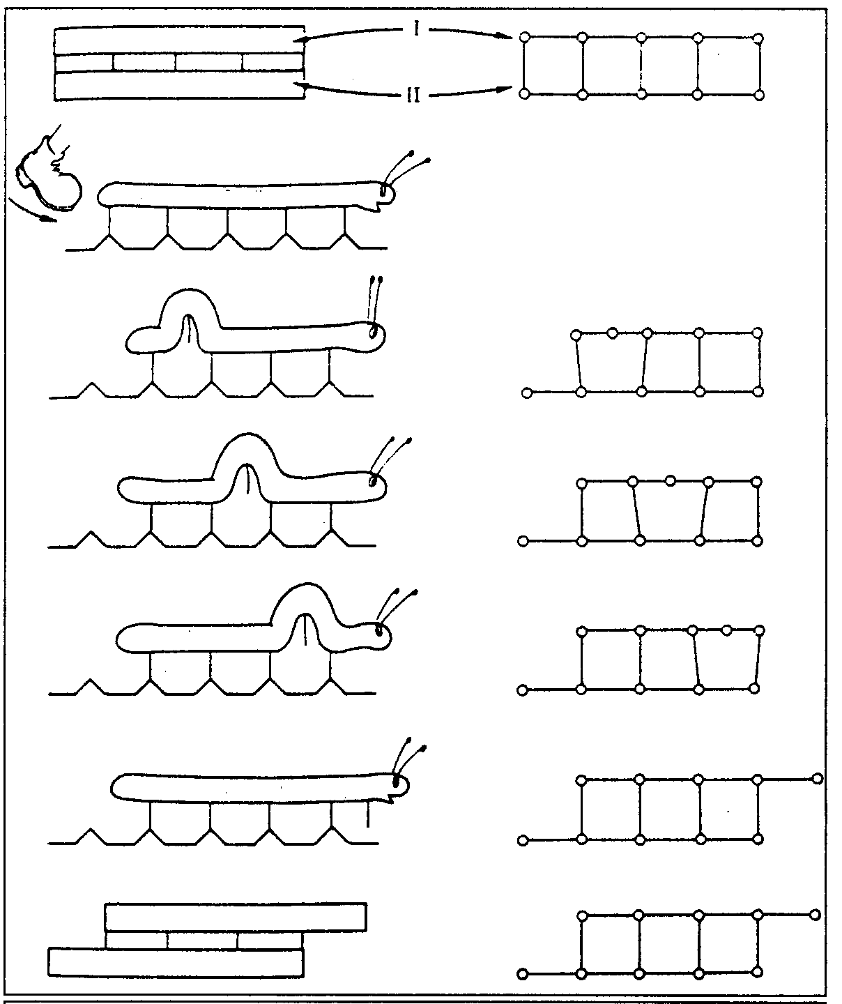

Slide 26
Linear Defects (Dislocations)
  Are one-dimensional defects around which atoms are misaligned
Edge dislocation:
  extra half-plane of atoms inserted in a crystal structure
  b ⊥ to dislocation line
Screw dislocation:
  spiral planar ramp resulting from shear deformation
  b || to dislocation line
Burger’s vector, b: measure of lattice distortion

Slide 27
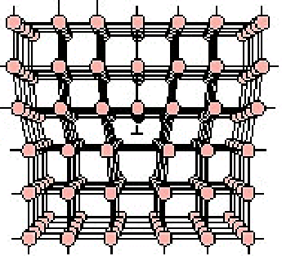
Dislocations = Linear Defects
插入平面
Interatomic bonds significantly distorted in immediate vicinity of dislocation line

Slide 28
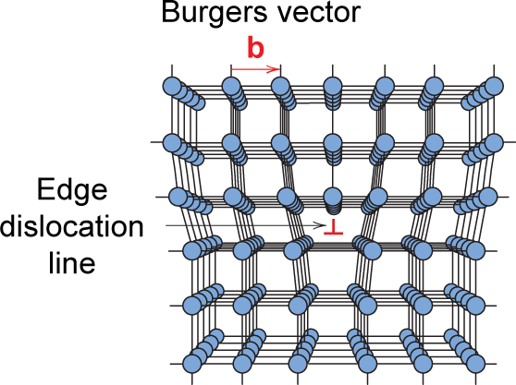
Edge Dislocation

Slide 29
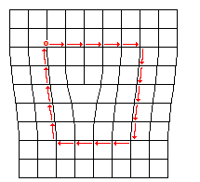
Describe Dislocations →Burgers Vector
Burgers vector, b, describes size + direction of lattice distortion by a dislocation.
Make a circuit around dislocation: go from atom to atom counting the same number of atomic distances in both directions.
Vector needed to close loop is b
b

Slide 30
Burgers vector above directed perpendicular to dislocation line.
These are called edge dislocations.

Slide 31
Burgers 線路（circuit）：
圍繞並垂直於差排線之線路
Burgers 向量（vector）：
決定晶格偏離方向與大小之向量

Slide 32
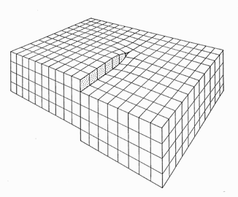
Screw dislocations
Edge dislocation: Burgers vector perpendicular to dislocation line.
Screw dislocation: parallel to the direction in which the crystal is being displaced
Burgers vector parallel to dislocation line

Slide 33
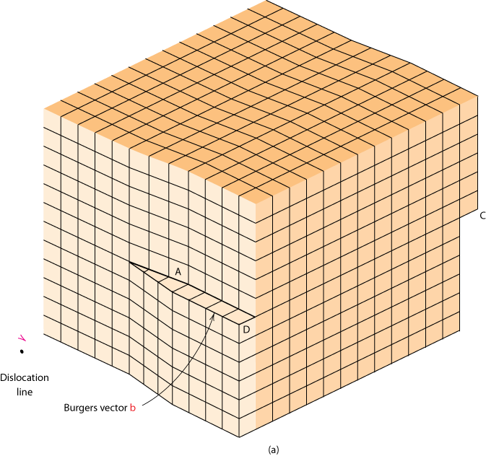
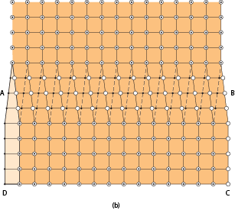
Screw Dislocation
Screw Dislocation
剪力作用
Dislocation
line
b
Burgers vector b
(b)
(a)

Slide 34
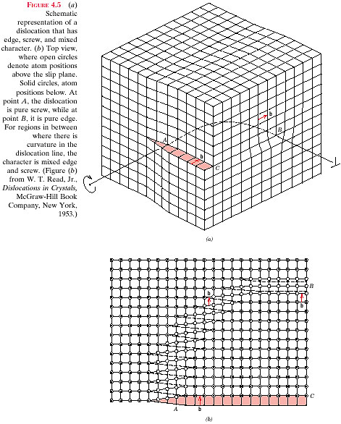
edge ⊥
dislocation

Slide 35
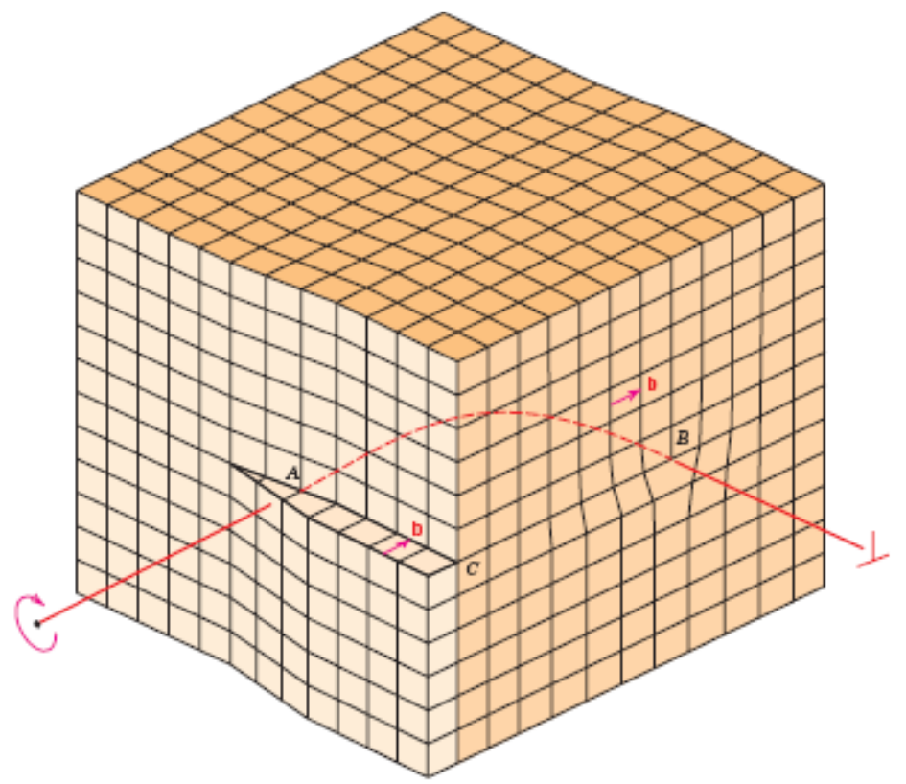
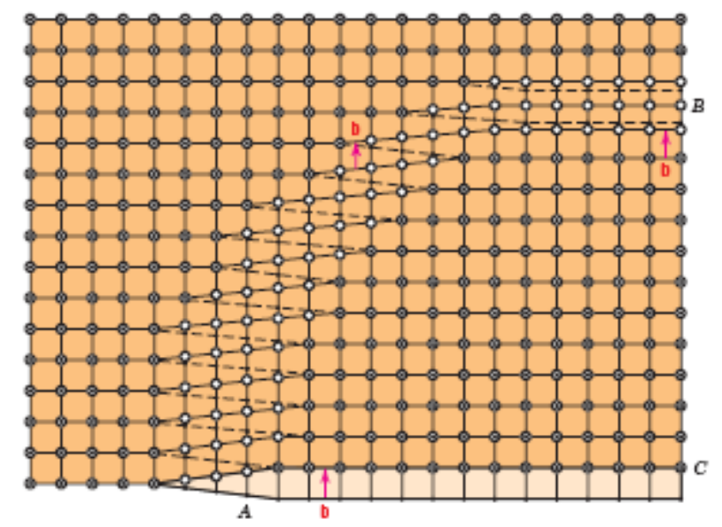
Edge, Screw, and Mixed Dislocations
Mixed
Edge
Screw

Slide 36
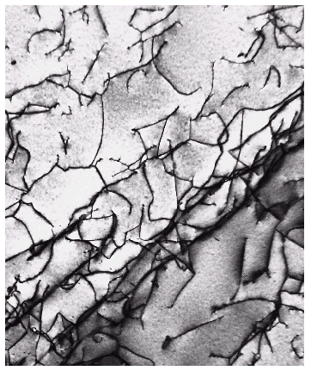
Dislocations are visible in electron micrographs

Slide 37
Interfacial Defects
including
•external surfaces
•grain boundaries
•twin boundaries
•stacking fault
•phase boundaries

Slide 38
External Surfaces
Surface atoms
→ unsatisfied bonds
higher energies than bulk atoms
Surface energy, γ (J/m²)
Surface areas try to minimize (e.g. liquid drop)
Solid surfaces can “reconstruct” to satisfy atomic
bonds at surfaces.

Slide 39
Grain Boundaries
Polycrystalline: many small crystals or grains. Grains have different crystallographic orientation. Mismatches where grains meet.
1. Surfaces and interfaces are reactive
2. Impurities tend to segregate there.
3. Extra energy associated with interfaces
→ larger grains tend to grow by diffusion of atoms at expense of smaller grains, minimizing energy.

Slide 40
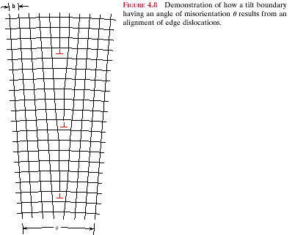

Slide 41
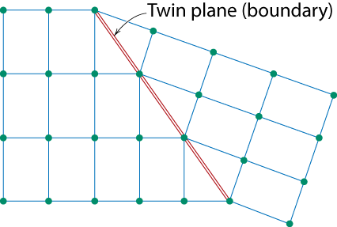
One case is a twin boundary (plane)
  Essentially a reflection of atom positions across the twin plane.

Slide 42
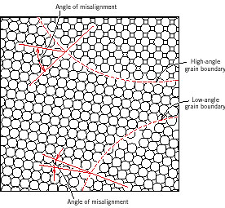
High and Low Angle Grain Boundaries
Misalignments of atomic planes between grains → Distinguish low and high angle grain boundaries

Slide 43
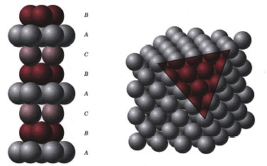
Stacking faults
  For FCC metals an error in ABCABC packing sequence
  Ex: ABCABABC
FCC: Stacking Sequence ABCABCABC...

Slide 44
Stacking Fault
ex : FCC with stacking sequence
ABCABC ABC
→ addition or lost of a plane
ABCBCABC or ABCAABCABC

Slide 45
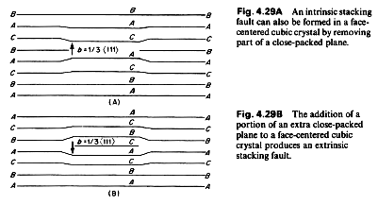

Slide 46
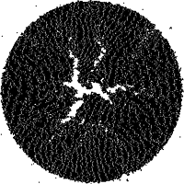
Bulk or Volume Defects
Pores: affect optical, thermal, mechanical properties
Cracks: affect mechanical properties
Foreign inclusions: affect electrical, mechanical, optical properties
Cluster of microcracks in a melanin granule irradiated by a short laser pulse. Computer simulation by L. V. Zhigilei and B. J. Garrison.

Slide 47
Atomic Vibrations
Heat causes atoms to vibrate
Vibration amplitude increases with temperature
Melting occurs when vibrations are sufficient to rupture bonds
Vibrational frequency ~ 10¹³ Hz
Average atomic energy due to thermal excitation is of order kT

Slide 48
Crystallites (grains) and grain boundaries. Vary considerably in size. Can be quite large
  ex: Large single crystal of quartz or diamond or Si
  ex: Aluminum light post or garbage can - see the individual grains
Crystallites (grains) can be quite small (mm or less) – necessary to observe with a microscope.

Slide 49
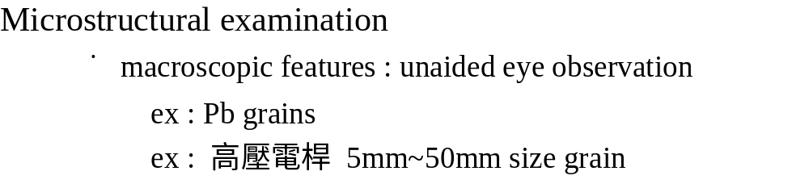
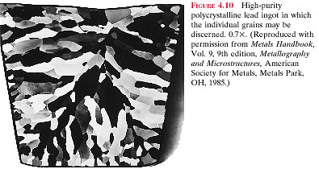


Slide 50
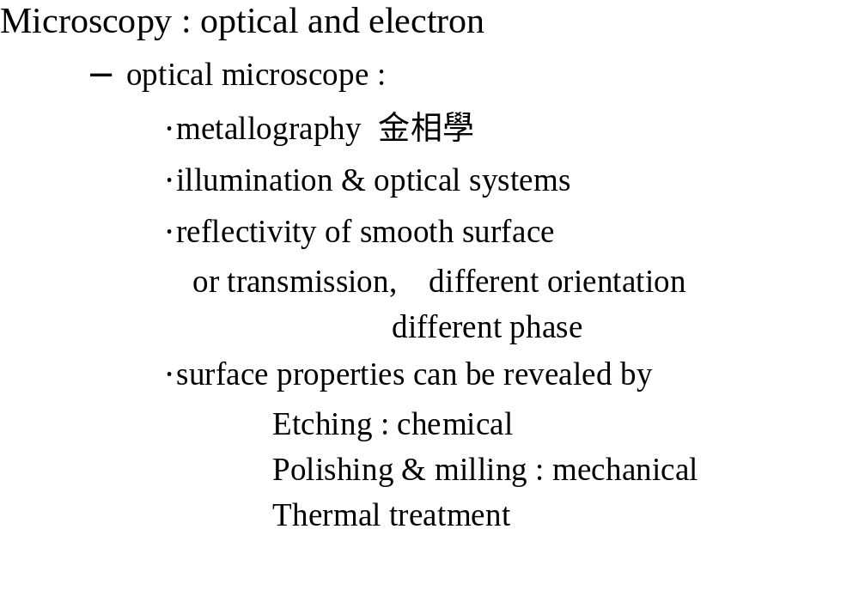

Slide 51
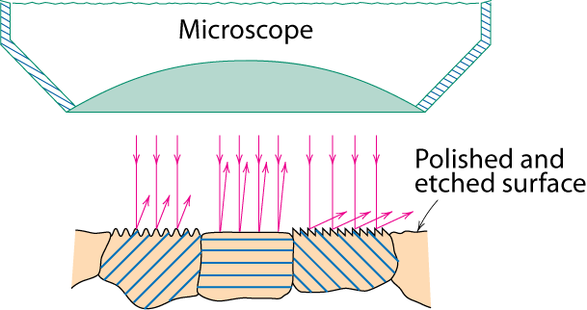
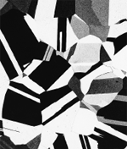
Optical Microscopy
• Useful up to 2000X magnification.
• Polishing removes surface features (e.g., scratches)
• Etching changes reflectance, depending on crystal
orientation.
crystallographic planes
Micrograph of
brass (a Cu-Zn alloy)
0.75mm

Slide 52
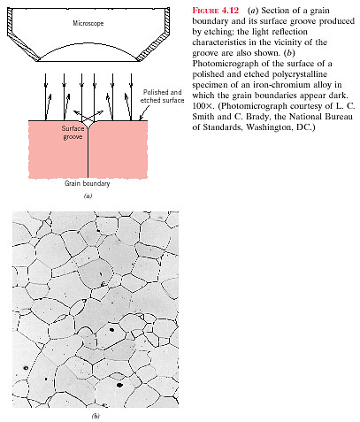
g.b. has higher Gibbs free energy
⇒etching rate is faster
Pore or second
phase grain
Fe-Cr alloy

Slide 53
Polarized light
  metallographic scopes often use polarized light to increase contrast
  Also used for transparent samples such as polymers

Slide 54
Optical resolution ca. 10⁻⁷ m = 0.1 μm = 100 nm
For higher resolution need higher frequency
  X-Rays? Difficult to focus.
  Electrons
    wavelengths ca. 3 pm (0.003 nm)
      (Magnification - 1,000,000X)
    Atomic resolution possible
    Electron beam focused by magnetic lenses.

Slide 55
電子顯微鏡
Electron Microscope
掃瞄式顯微鏡 Scanning electron microscope
穿透式顯微鏡 Transmission electron microscope
電子顯微鏡主要的用途即在辨明各種訊號以作晶體結構、微細組織、化學成份、化學鍵結和電子分佈情況分析。

Slide 56
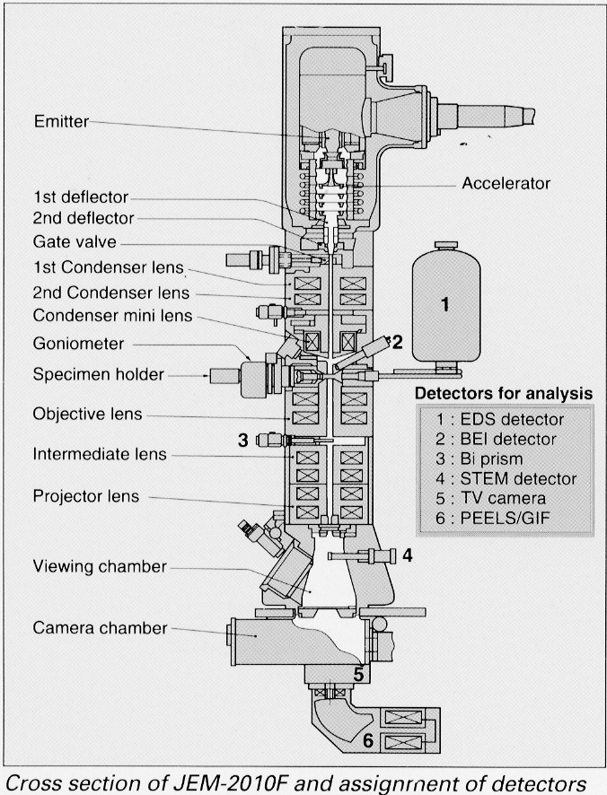
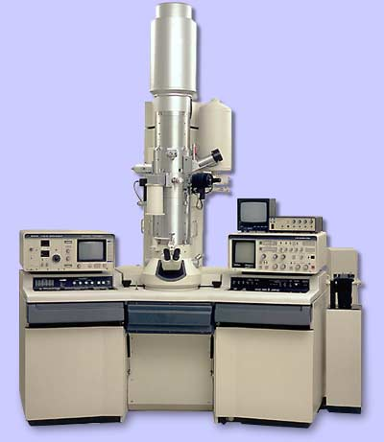
Hitachi 9000

Slide 57
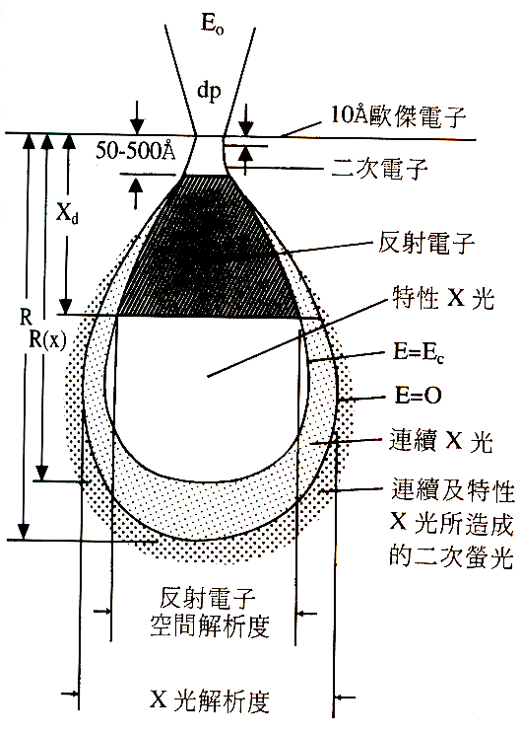

Slide 58
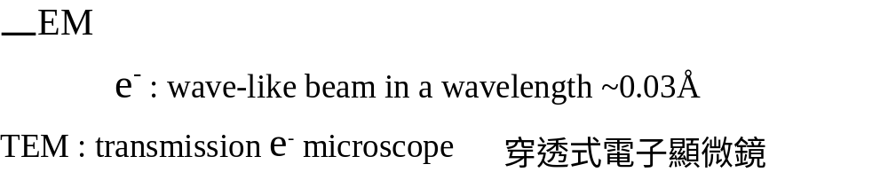
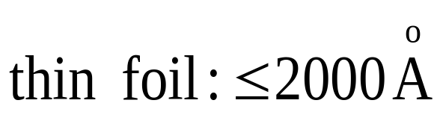
Magnification maximum
~ 100萬倍

Slide 59


SEM : scanning e⁻ microscope
back scattered e⁻
detector
secondary e⁻
TV or
film system
x-ray
Sample

Slide 60
掃瞄探針顯微鏡(SPM)
Scanning Probe Microscopy
掃描探針顯微技術（Scanning Probe Microscopy：SPM）係指具有『掃描機制與動作』及『微細探針機制』的顯微技術

Slide 61
Scanning probe microscopy (SPM) is a relatively new family of microscope that can measure surface morphology down to atomic resolution.
Scanning tunneling microscopy (STM)
Atomic force microscopy (AFM)

Slide 62
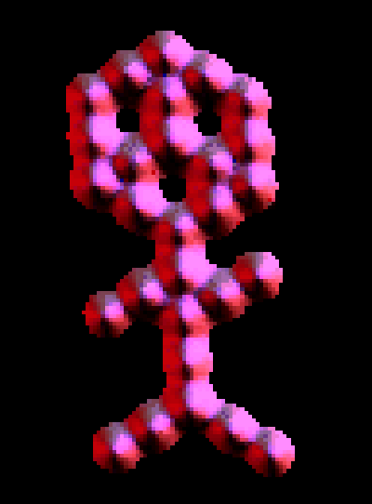
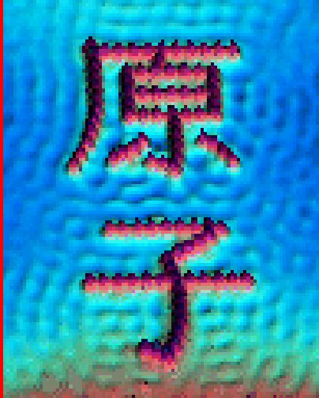
Scanning Tunneling Microscopy
(STM)
• Atoms can be arranged and imaged!
Carbon monoxide molecules arranged on a platinum (111) surface.
Iron atoms arranged on a copper (111) surface. These Kanji characters represent the word “atom”.

Slide 63
Grain size determination
•must using an intercept method (交線法)
•ASTM : standardized “ grain size # ”
1~10 (= n)
N ( average # of grain/in² ) = 2^{n-1}
in 100x magnification

Slide 64
4.2
Calculate the number of vacancies per cubic meter in gold at 900℃. The energy for vacancy formation is 0.98 eV/atom. Furthermore, the density and atomic weight for Au are 19.32 g/cm³ and 196.9 g/mol, respectively.

Slide 65
4.17
Calculate the unit cell edge length for an 80 wt% Ag-20 wt% Pd alloy. All of the palladium is in solid solution, the crystal structure for this alloy is FCC. The atomic weights for Ag and Pd are 107.9 and 106.4 g/mol, respectively, whereas the densities for the Ag and Pd are 10.49 g/cm³ and 12.02 g/cm³.

